Slide 1
Ontology Languages for the
Semantic Web

Slide 2
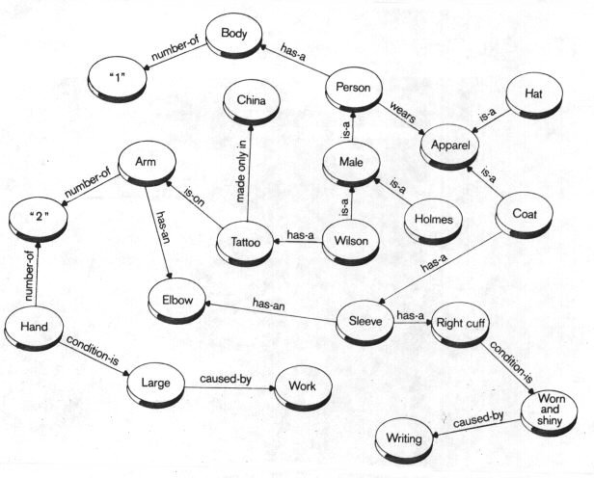
Ontology Languages
Wide variety of languages for “Explicit Specification”
  Graphical notations
    Semantic networks

Slide 3
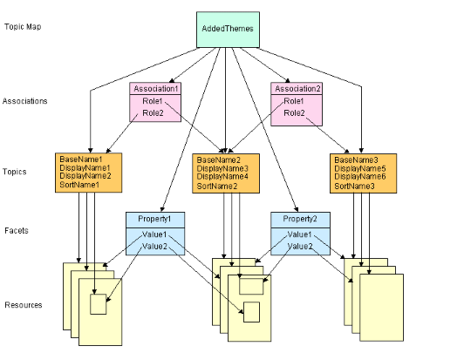
Ontology Languages
Wide variety of languages for “Explicit Specification”
  Graphical notations
    Topic Maps

Slide 4
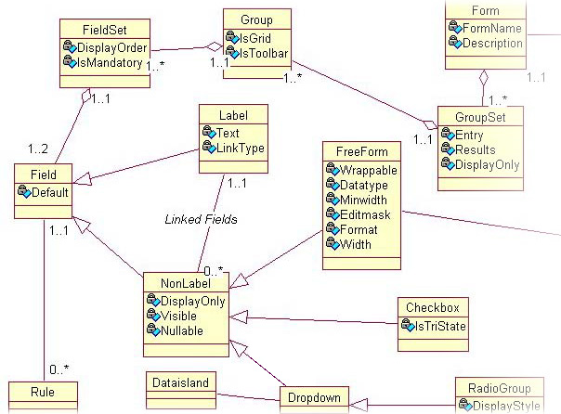
Ontology Languages
Wide variety of languages for “Explicit Specification”
  Graphical notations
    UML

Slide 5
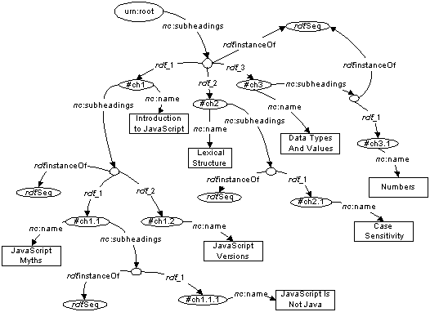
Ontology Languages
Wide variety of languages for “Explicit Specification”
  Graphical notations
    RDF

Slide 6
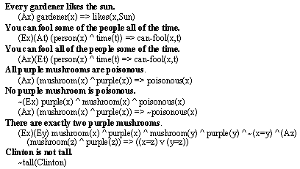
Ontology Languages
Wide variety of languages for “Explicit Specification”
  Logic based
    Description Logics (e.g., OIL, DAML+OIL, OWL)
    Rules (e.g., RuleML, LP/Prolog)
    First Order Logic (e.g., KIF)

Slide 7
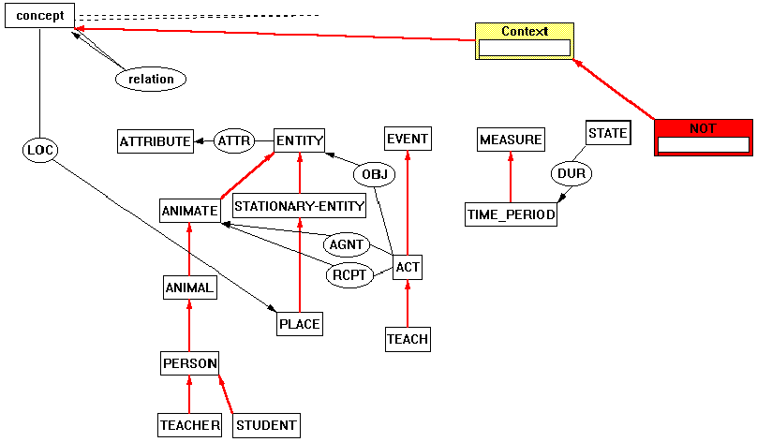
Ontology Languages
Wide variety of languages for “Explicit Specification”
  Logic based
    Conceptual graphs

Slide 8
Ontology Languages
Wide variety of languages for “Explicit Specification”
  Logic based
    Conceptual graphs
    (Syntactically) higher order logics (e.g., LBase)
    Non-classical logics (e.g., Flogic, Non-Mon, modalities)
  Bayesian/probabilistic/fuzzy
Degree of formality varies widely
  Increased formality makes languages more amenable to machine processing (e.g., automated reasoning)

Slide 9
Many languages use “object oriented” model based on:
Objects/Instances/Individuals
  Elements of the domain of discourse
  Equivalent to constants in FOL
Types/Classes/Concepts
  Sets of objects sharing certain characteristics
  Equivalent to unary predicates in FOL
Relations/Properties/Roles
  Sets of pairs (tuples) of objects
  Equivalent to binary predicates in FOL
Such languages are/can be:
  Well understood
  Formally specified
  (Relatively) easy to use
  Amenable to machine processing

Slide 10
Web “Schema” Languages
Existing Web languages extended to facilitate content description
  XML → XML Schema (XMLS)
  RDF → RDF Schema (RDFS)
XMLS not an ontology language
  Changes format of DTDs (document schemas) to be XML
  Adds an extensible type hierarchy
    Integers, Strings, etc.
    Can define sub-types, e.g., positive integers
RDFS is recognisable as an ontology language
  Classes and properties
  Sub/super-classes (and properties)
  Range and domain (of properties)

Slide 11
RDF and RDFS
RDF stands for Resource Description Framework
It is a W3C candidate recommendation (http://www.w3.org/RDF)
RDF is graphical formalism ( + XML syntax + semantics)
  for representing metadata
  for describing the semantics of information in a machine- accessible way
RDFS extends RDF with “schema vocabulary”, e.g.:
  Class, Property
  type, subClassOf, subPropertyOf
  range, domain

Slide 12
The RDF Data Model
Statements are <subject, predicate, object> triples:
Ian
hasColleague
Uli
Can be represented using XML serialisation, e.g.:
  <Ian,hasColleague,Uli>
Statements describe properties of resources
A resource is a URI representing a (class of) object(s):
  a document, a picture, a paragraph on the Web;
  http://www.cs.man.ac.uk/index.html
  a book in the library, a real person (?)
  isbn://5031-4444-3333
  …
Properties themselves are also resources (URIs)

Slide 13
URIs
URI = Uniform Resource Identifier
"The generic set of all names/addresses that are short strings that refer to resources“
URIs may or may not be dereferencable
  URLs (Uniform Resource Locators) are a particular type of URI, used for resources that can be accessed on the WWW (e.g., web pages)
In RDF, URIs typically look like “normal” URLs, often with fragment identifiers to point at specific parts of a document:
  http://www.somedomain.com/some/path/to/file#fragmentID

Slide 14
Linking Statements
The subject of one statement can be the object of another
Such collections of statements form a directed, labeled graph
Note that the object of a triple can also be a “literal” (a string)
Ian
hasColleague
Uli
hasHomePage
hasColleague
Carole
http://www.cs.mam.ac.uk/~sattler

Slide 15
RDF Syntax
RDF has an XML syntax that has a specific meaning:
Every Description element describes a resource
Every attribute or nested element inside a Description is a property of that Resource with an associated object resource
Resources are referred to using URIs
<Description about="some.uri/person/ian_horrocks">
<hasColleague resource="some.uri/person/uli_sattler"/>
</Description>
<Description about="some.uri/person/uli_sattler">
<hasHomePage>http://www.cs.mam.ac.uk/~sattler</hasHomePage>
</Description>
<Description about="some.uri/person/carole_goble">
<hasColleague resource="some.uri/person/uli_sattler"/>
</Description>

Slide 16
RDF Schema (RDFS)
RDF gives a formalism for meta data annotation, and a way to write it down in XML, but it does not give any special meaning to vocabulary such as subClassOf or type
  Interpretation is an arbitrary binary relation
  I.e., <Person,subClassOf,Animal> has no special meaning
RDF Schema defines “schema vocabulary” that supports definition of ontologies
  gives “extra meaning” to particular RDF predicates and resources (such as subClasOf)
  this “extra meaning”, or semantics, specifies how a term should be interpreted

Slide 17
RDFS Examples
RDF Schema terms (just a few examples):
  Class
  Property
  type
  subClassOf
  range
  domain
These terms are the RDF Schema building blocks (constructors) used to create vocabularies:
  <Person,type,Class>
  <hasColleague,type,Property>
  <Professor,subClassOf,Person>
  <Carole,type,Professor>
  <hasColleague,range,Person>
  <hasColleague,domain,Person>

Slide 18
RDF/RDFS “Liberality”
No distinction between classes and instances (individuals)
  <Species,type,Class>
  <Lion,type,Species>
  <Leo,type,Lion>
Properties can themselves have properties
  <hasDaughter,subPropertyOf,hasChild>
  <hasDaughter,type,familyProperty>
No distinction between language constructors and ontology vocabulary, so constructors can be applied to themselves/each other
  <type,range,Class>
  <Property,type,Class>
  <type,subPropertyOf,subClassOf>

Slide 19
RDF/RDFS Semantics
RDF has “Non-standard” semantics in order to deal with this
Semantics given by RDF Model Theory (MT)

Slide 20
Aside: Semantics and Model Theories
Ontology/KR languages aim to model (part of) world
Terms in language correspond to entities in world
Meaning given by, e.g.:
  Mapping to another formalism, such as FOL, with own well defined semantics
  or a bespoke Model Theory (MT)
MT defines relationship between syntax and interpretations
  Can be many interpretations (models) of one piece of syntax
  Models supposed to be analogue of (part of) world
    E.g., elements of model correspond to objects in world
  Formal relationship between syntax and models
    Structure of models reflect relationships specified in syntax
  Inference (e.g., subsumption) defined in terms of MT
    E.g., T ² A v B iff in every model of T, ext(A) µ ext(B)

Slide 21
Aside: Set Based Model Theory
Many logics (including standard First Order Logic) use a model theory based on Zermelo-Frankel set theory
The domain of discourse (i.e., the part of the world being modelled) is represented as a set (often refered as Δ)
Objects in the world are interpreted as elements of Δ
  Classes/concepts (unary predicates) are subsets of Δ
  Properties/roles (binary predicates) are subsets of Δ £ Δ (i.e., Δ²)
  Ternary predicates are subsets of Δ³ etc.
The sub-class relationship between classes can be interpreted as set inclusion
Doesn’t work for RDF, because in RDF a class (set) can be a member (element) of another class (set)
  In Z-F set theory, elements of classes are atomic (no structure)

Slide 22
Aside: Set Based Model Theory Example
World
Model
Interpretation
Δ
Daisy isA Cow
Cow kindOf Animal
Mary isA Person
Person kindOf Animal
a
Z123ABC isA Car
b
Mary drives Z123ABC
{ha,bi,…} µ Δ £ Δ

Slide 23
Aside: Set Based Model Theory Example
Formally, the vocabulary is the set of names we use in our model of (part of) the world
  {Daisy, Cow, Animal, Mary, Person, Z123ABC, Car, drives, …}
An interpretation I is a tuple h Δ, ¢^{I} i
  Δ is the domain (a set)
  ¢^{I} is a mapping that maps
    Names of objects to elements of Δ
    Names of unary predicates (classes/concepts) to subsets of Δ
    Names of binary predicates (properties/roles) to subsets of Δ £ Δ
    And so on for higher arity predicates (if any)

Slide 24
RDF Semantics
RDF has “Non-standard” semantics in order to deal with this
Semantics given by RDF Model Theory (MT)
In RDF MT, an interpretation I of a vocabulary V consists of:
  IR, a non-empty set of resources (corresponds to Δ)
  IS, a mapping from V into IR (corresponds to ¢^{I} )
  IP, a distinguished subset of IR (the properties)
    A vocabulary element v 2 V is a property iff IS(v) 2 IP
  IEXT, a mapping from IP into the powerset of IR£IR
    I.e., property elements mapped to subsets of IR£IR
  IL, a mapping from typed literals into IR

Slide 25
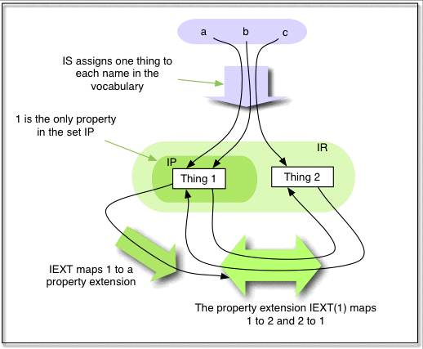
Example RDF Simple Interpretation

Slide 26
RDF Semantic Conditions
RDF Imposes semantic conditions on interpretations, e.g.:
  x is in IP if and only if <x, IS(rdf:Property)> is in IEXT(I(rdf:type))
All RDF interpretations must satisfy certain axiomatic triples, e.g.:
  rdf:type rdf:type rdf:Property
  rdf:subject rdf:type rdf:Property
  rdf:predicate rdf:type rdf:Property
  rdf:object rdf:type rdf:Property
  rdf:first rdf:type rdf:Property
  rdf:rest rdf:type rdf:Property
  rdf:value rdf:type rdf:Property
  …

Slide 27
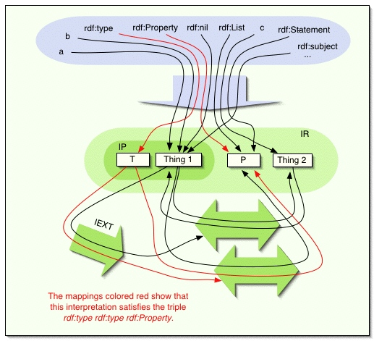
Example RDF Interpretation

Slide 28
RDFS Semantics
RDFS simply adds semantic conditions and axiomatic triples that give meaning to schema vocabulary
Class interpretation ICEXT simply induced by rdf:type, i.e.:
  x is in ICEXT(y) if and only if <x,y> is in IEXT(IS(rdf:type))
Other semantic conditions include:
  If <x,y> is in IEXT(IS(rdfs:domain)) and <u,v> is in IEXT(x) then u is in ICEXT(y)
  If <x,y> is in IEXT(IS(rdfs:subClassOf)) then x and y are in IC and ICEXT(x) is a subset of ICEXT(y)
  IEXT(IS(rdfs:subClassOf)) is transitive and reflexive on IC
Axiomatic triples include:
  rdf:type rdfs:domain rdfs:Resource
  rdfs:domain rdfs:domain rdf:Property

Slide 29
RDFS Interpretation Example
If RDFS graph includes triples
  <Species,type,Class> <Lion,type,Species> <Leo,type,Lion> <Lion,subClassOf,Mamal> <Mamal,subClassOf,Animal>
Interpretation conditions imply existence of triples
  <Lion,subClassOf,Animal> <Leo,type,Mamal> <Leo,type,Animal>
  …

Slide 30
Problems with RDFS
RDFS too weak to describe resources in sufficient detail
  No localised range and domain constraints
    Can’t say that the range of hasChild is person when applied to persons and elephant when applied to elephants
  No existence/cardinality constraints
    Can’t say that all instances of person have a mother that is also a person, or that persons have exactly 2 parents
  No transitive, inverse or symmetrical properties
    Can’t say that isPartOf is a transitive property, that hasPart is the inverse of isPartOf or that touches is symmetrical
  …
Difficult to provide reasoning support
  No “native” reasoners for non-standard semantics
  May be possible to reason via FO axiomatisation

Slide 31
Web Ontology Language Requirements
Desirable features identified for Web Ontology Language:
Extends existing Web standards
  Such as XML, RDF, RDFS
Easy to understand and use
  Should be based on familiar KR idioms
Formally specified
Of “adequate” expressive power
Possible to provide automated reasoning support

Slide 32
From RDF to OWL
Two languages developed to satisfy above requirements
  OIL: developed by group of (largely) European researchers (several from EU OntoKnowledge project)
  DAML-ONT: developed by group of (largely) US researchers (in DARPA DAML programme)
Efforts merged to produce DAML+OIL
  Development was carried out by “Joint EU/US Committee on Agent Markup Languages”
  Extends (“DL subset” of) RDF
DAML+OIL submitted to W3C as basis for standardisation
  Web-Ontology (WebOnt) Working Group formed
  WebOnt group developed OWL language based on DAML+OIL
  OWL language now a W3C Recommendation (i.e., a standard like HTML and XML)

Slide 33
OWL Language
Three species of OWL
  OWL full is union of OWL syntax and RDF
  OWL DL restricted to FOL fragment (¼ DAML+OIL)
  OWL Lite is “easier to implement” subset of OWL DL
Semantic layering
  OWL DL ¼ OWL full within DL fragment
  DL semantics officially definitive
OWL DL based on SHIQ Description Logic
  In fact it is equivalent to SHOIN(D_{n}) DL
OWL DL Benefits from many years of DL research
  Well defined semantics
  Formal properties well understood (complexity, decidability)
  Known reasoning algorithms
  Implemented systems (highly optimised)

Slide 34
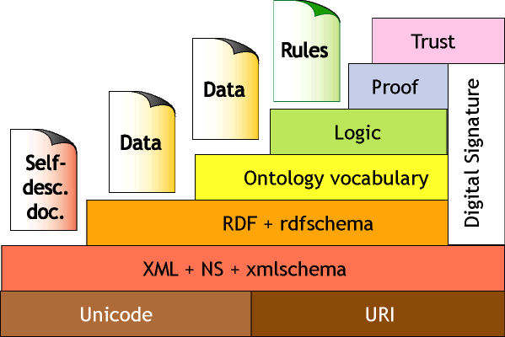
(In)famous “Layer Cake”
???
???
???
≈ Semantics+reasoning
?
≈ Relational Data
?
≈ Data Exchange
Relationship between layers is not clear
OWL DL extends “DL subset” of RDF

